Slide 1
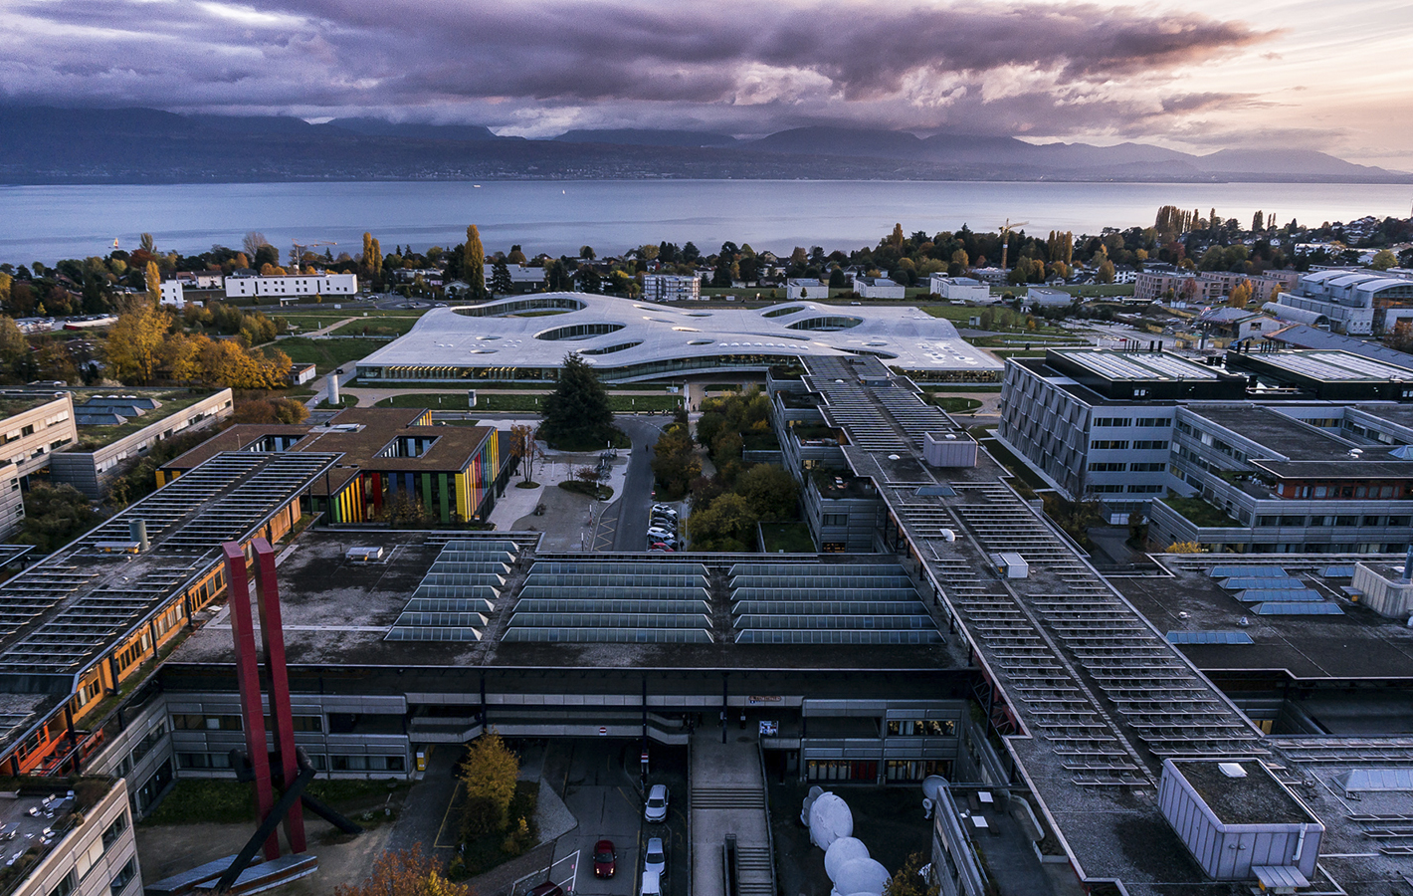
Did I miss something?
D. Foray
College of Management of Technology
October 2024
MGT 641

Slide 2

For this mission we need to…
Put (estimate) an economic value on something we want to protect, preserve, promote
Fix negative externalities (tax, regulation)
Change some existing business models
Design a sophisticated policy process – involving:
a coordinated push
social experiments
inclusion
Build a new innovation eco-system
Implement better mechanisms to monitor and measure transformations and effects
Promote & accelerate the development of critical tech.
Support the diffusion of technologies or practices which already exist
Stimulate international technology transfers
Find innovative funding mechanisms
Change social norms
Support education & training
And..?

